Slide 1

Yevhen Begman
Dear Everyone.
This is Yevhen Begman From Ukraine.
As I am a Software Development Expert with over 5 years of experience, I have mastered Javascript and its frameworks such as Nodejs, Angular js, Vue.js, React.js, Ionic, React-Native, NativeScript.
And I am well aware of the essential languages just like PHP, Python, C#. From junior ages, I was interested in computer and honestly, I was doing more than others in this computer usage. I started IT developing when I was studying at the university and I worked as freelancer with my challeagues. As the birth of Node.js and other frontend frameworks such as Angular.js, Javascript was getting more and more famous. So that , I have built several productions such as Back-end, Front-end using MEAN stack. Otherwhile, PHP was supported by many hosting services so I developed lots of projects using PHP frameworks such as Laravel, CI, Zend, CakePHP.
I have been working in remote jobs as well as working locally so published several successful projects like followings.
And you can check them on https://github.com/Lexy0309.
Promising only PERFECT product, Hope to work with you.
Best regards

Slide 2
Betting Site

Slide 3
Summary
This project is sports betting site which deals with sports matches all over the world. All matches and odds of them are received from oddsports.com. Football, baseball, basketball, American soccer, … and any other kinds of sports are performed.
This site also has many gambling games including Texas Holdem, Baduki(a kind of card games), Bitkong, Bustabit, power-ladder, power-ball, …
And it works across the user’s bank accounts so each client can use his cash and bitcoin at every time he wants.

Slide 4
Summary
This site can be divided into several sub-sites and also one main site which means that one company can have it’s sub-companies in several areas of the world which administrate this site with different functions and UI.
This site also has so many detailed functions of managing users, bettings and cash, UI.
It is developed from the scratch with FeathersJS(NodeJS Framework) as backend and nuxt.js(Vuejs Framework) as frontend. As you can easily notice that these two frameworks are known as newest and good fast interactive frameworks.

Slide 5
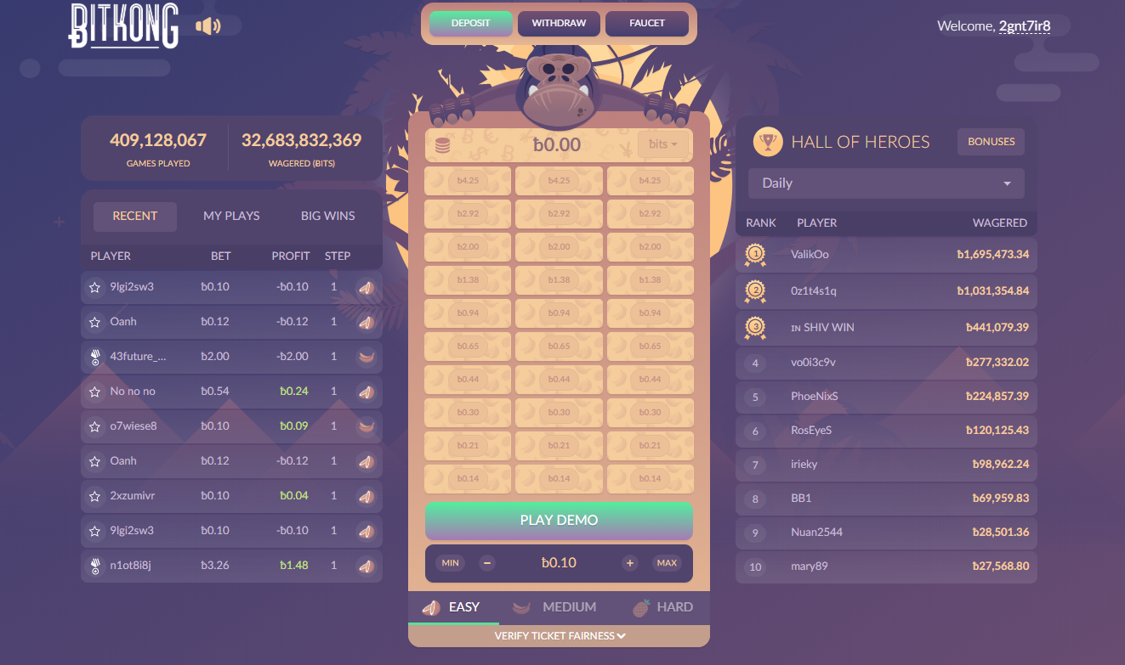
Bitkong Game
This page is Bitkong game page.
Everyone can easily find Bitkong game in bitkong.com and in this site there is completely same game as in bitkong.com.
The steps are set with betting money and levels of this game set odd of each step.
And there is a bonus on special days or conditions.
There is also two playing modes – Demo Play, Real Play.
As you can easily notice, in Demo Play mode betters do not use his cash or coupon.

Slide 6
North Country Lumber
(Landing Page, Admin Dashboard, Android & iOS mobile app) Laravel project

Slide 7
Summary
I have rich experience in developing projects using Laravel.
Especially for admin dashboard, I had developed projects which has complicated logic according to forestry logging.
This project has analysis, trading and payment management part as well.
And I had made app for android and iOS using IONIC.

Slide 8
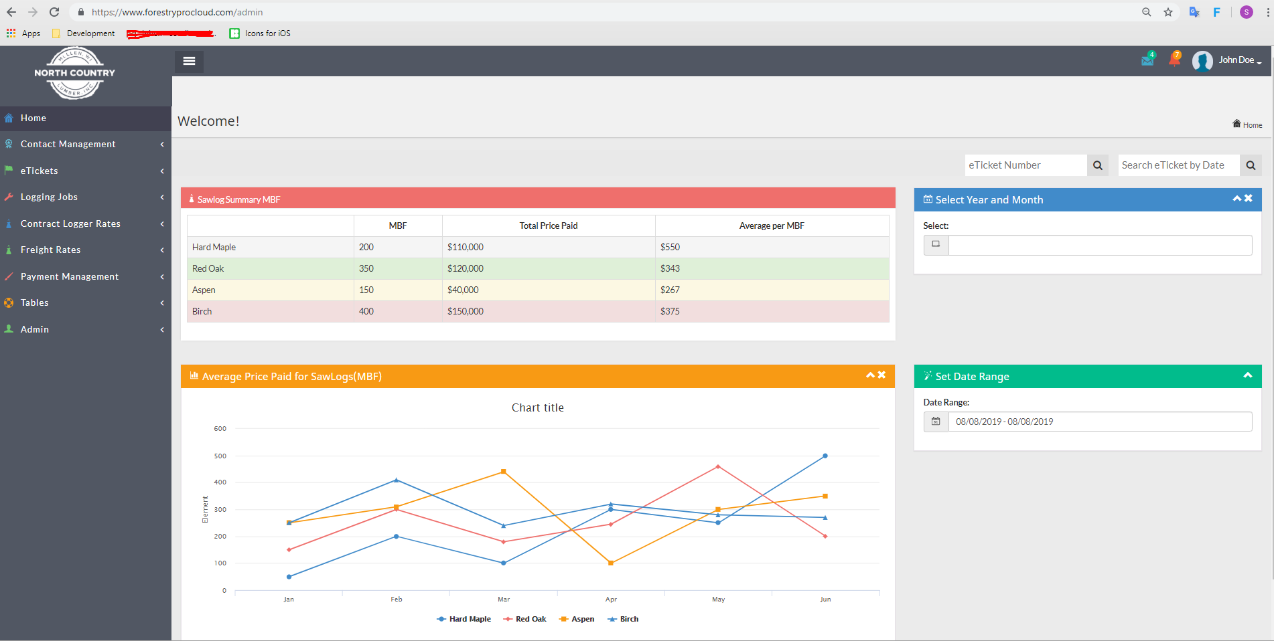
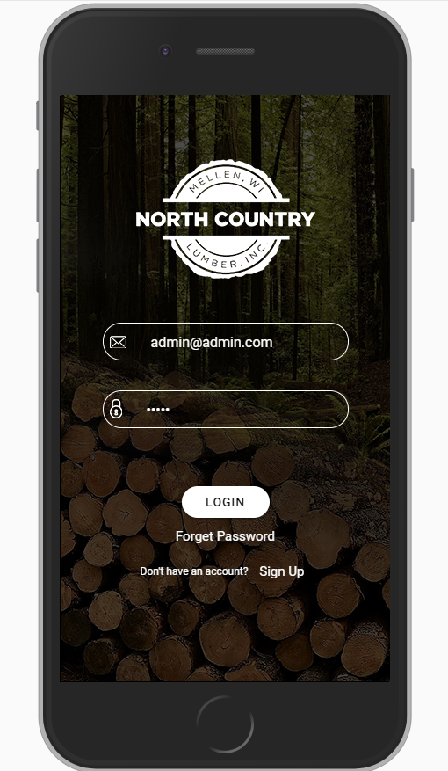

Slide 9
Food Delivery Website and App
This project has website, admin panel and mobile apps for android and iOS.
This can manage restaurant and menu, coupon, grocery and food delivery as well in the admin panel.
And there are roles for driver, customer and restaurant in the mobile app.
So you can manage not only restaurants but also users and cuisines, and drivers.

Slide 10
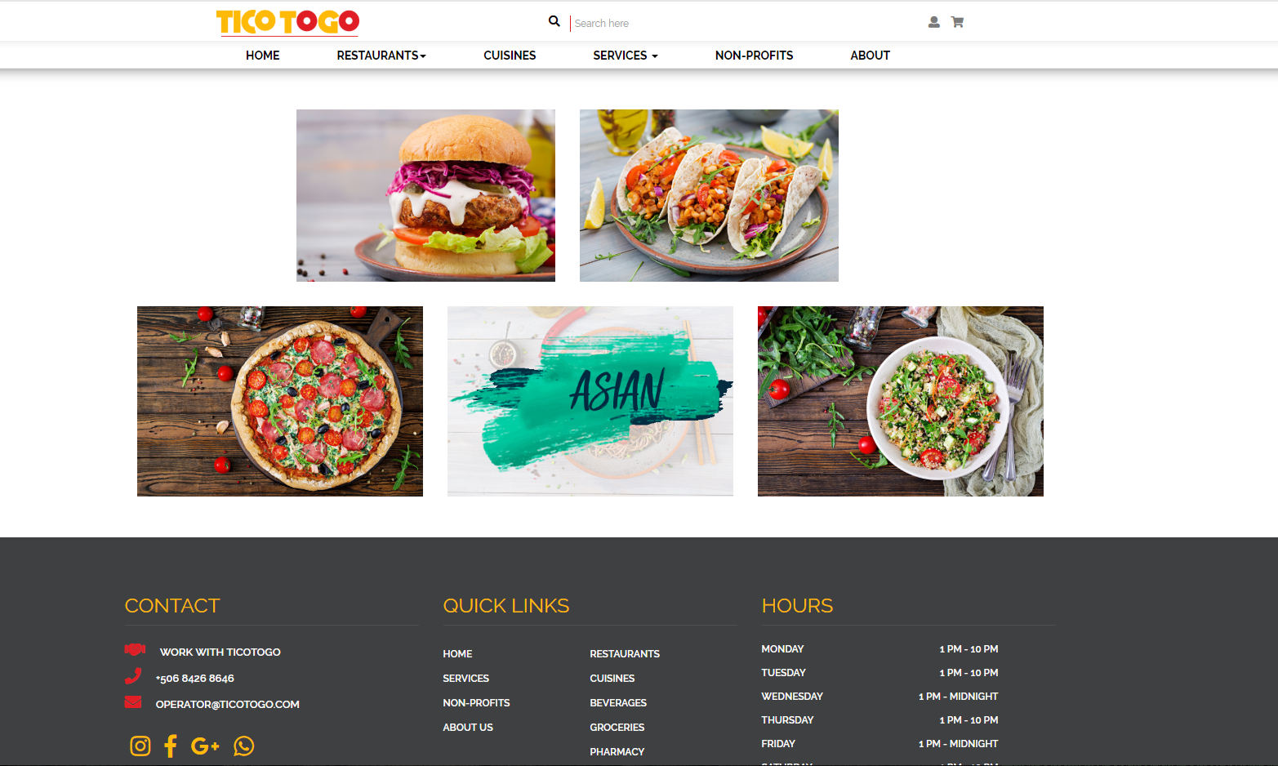


Slide 11
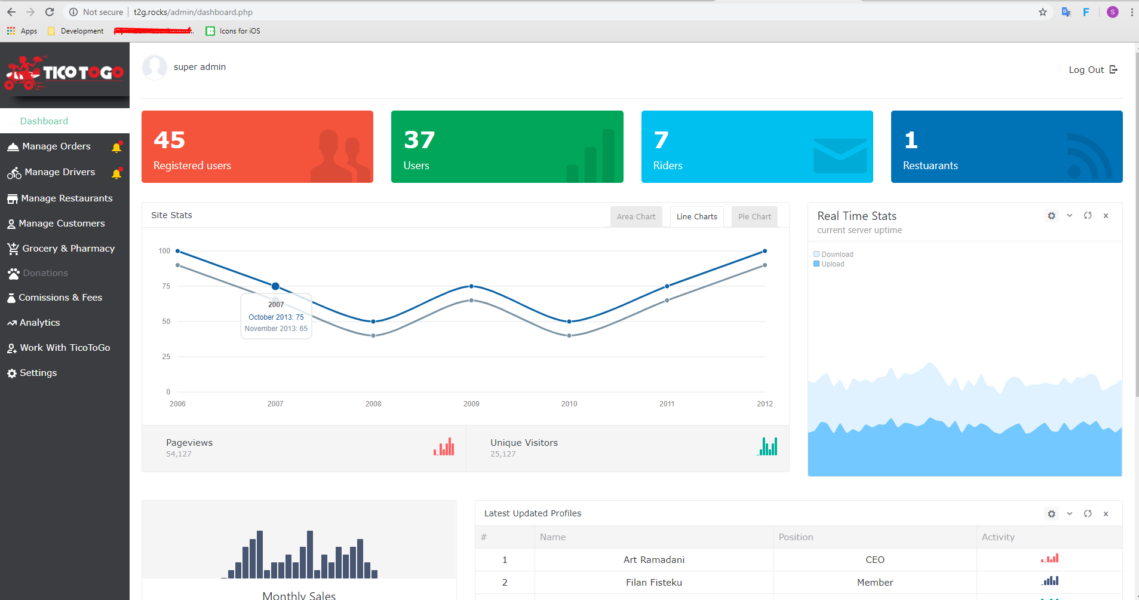

Slide 12
Chrome Extensions

Slide 13
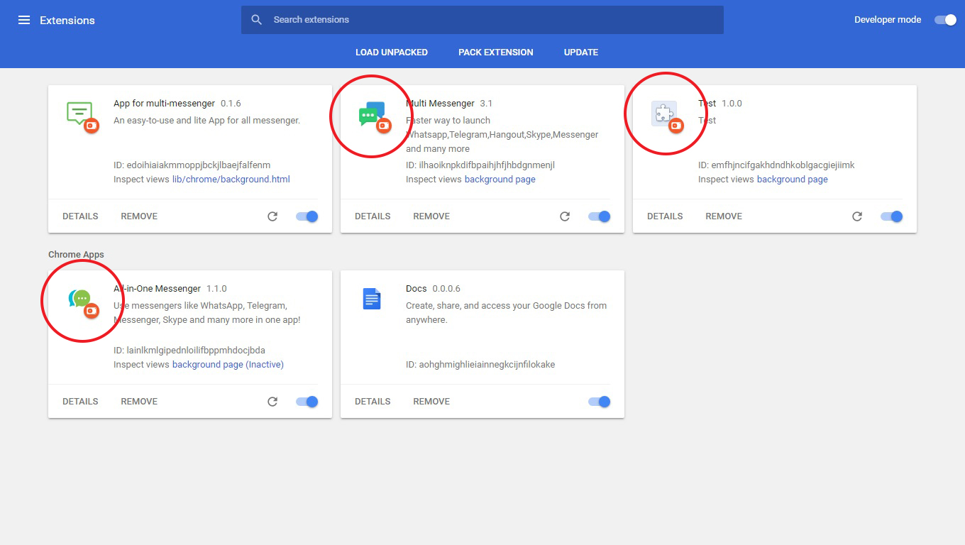
Three Extensions

Slide 14
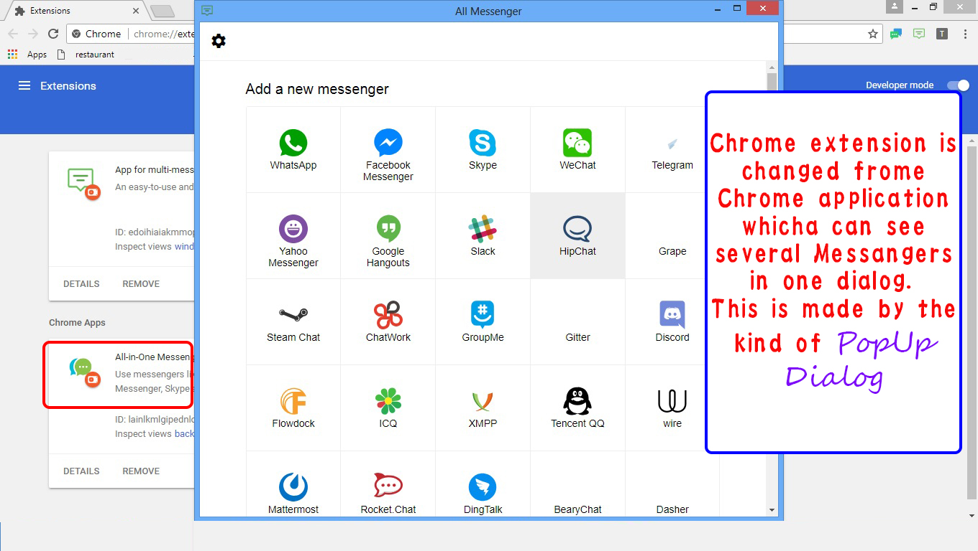
All-in-one Messenger

Slide 15
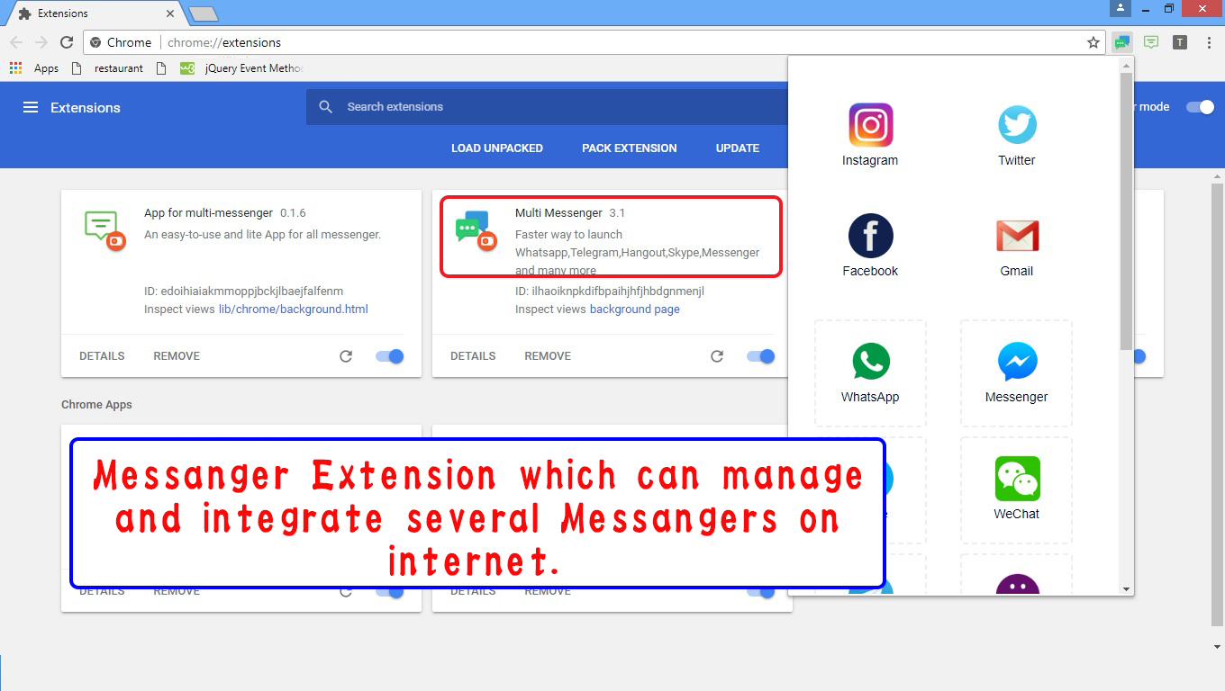
Multi Messenger

Slide 16
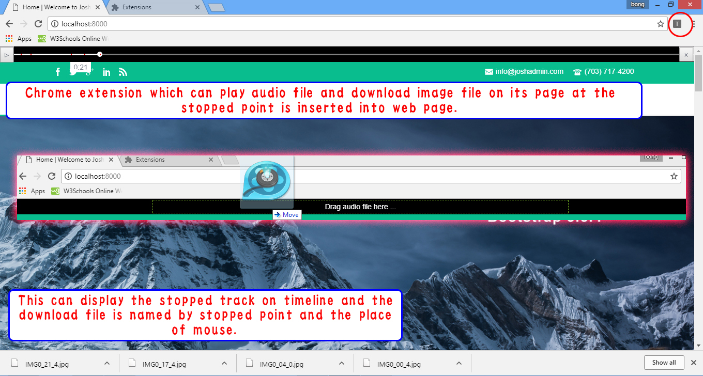
Educational Chrome Extension

Slide 17
Wordpress Plugin & Theme

Slide 18
Summary
WordPress responsive theme & plugin with free drag-drop page builder and powerful theme options panel and simple clean frontend design. Ability to modify styles and options according to your needs.
Translated to several languages.
Works perfect with BuddyPress, WPML, Contact form 7, WooCommerce till version 3.0.
Free Drag & Drop Page Builder
Simple Design
Wordpress Responsive

Slide 19
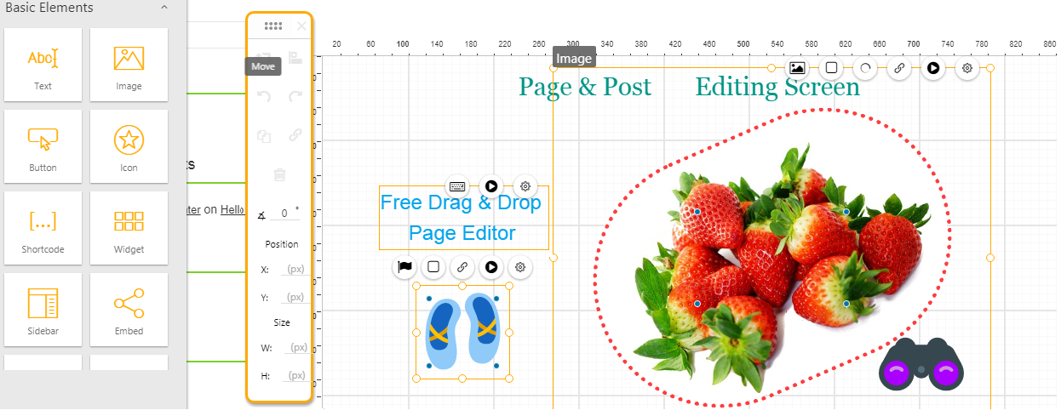
Screenshot

Slide 20
Banner Builder Site

Slide 21
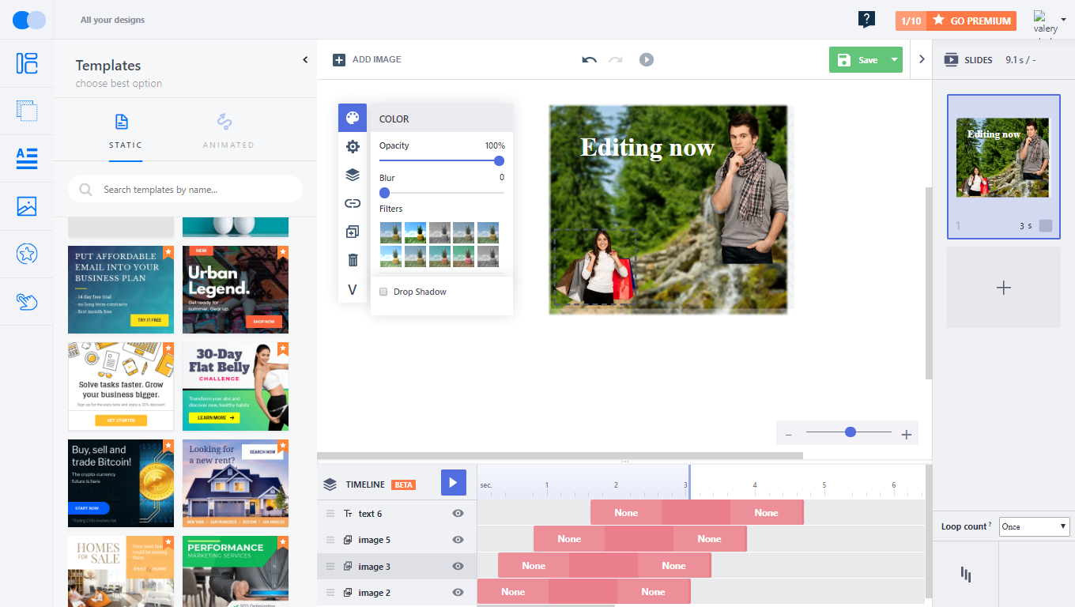
Summary
This Banner building site can build any kind of banners of static, dynamic and collating and users can save it as image or web template.
Users don’t need to know any operations except drag-drop and all functions are performed so that they can use it freely.
In this site, the CMS is implemented which means that page builder project is my confident one.

Slide 22
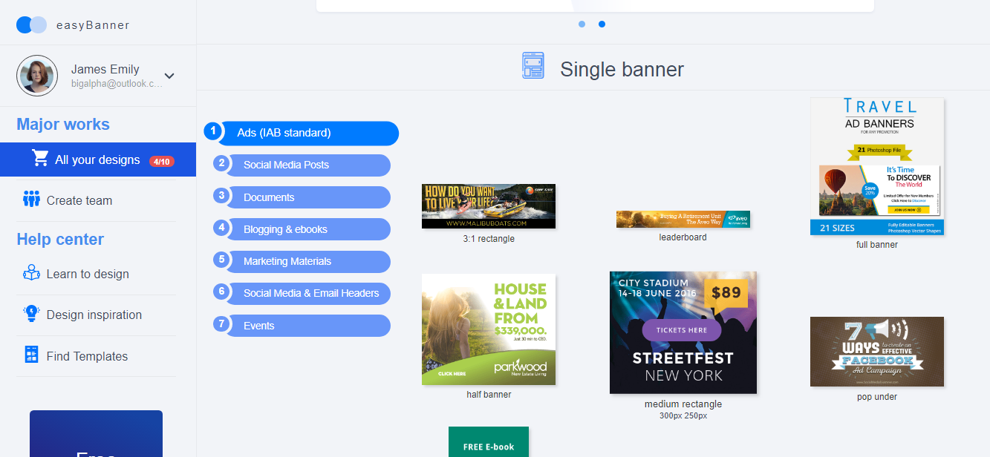
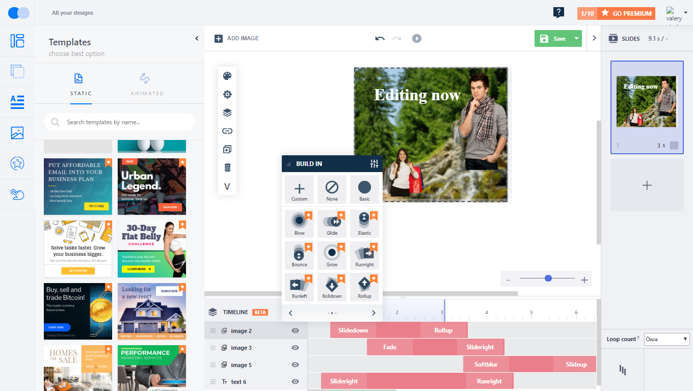

Slide 23
Senior Report
(CI project)

Slide 24
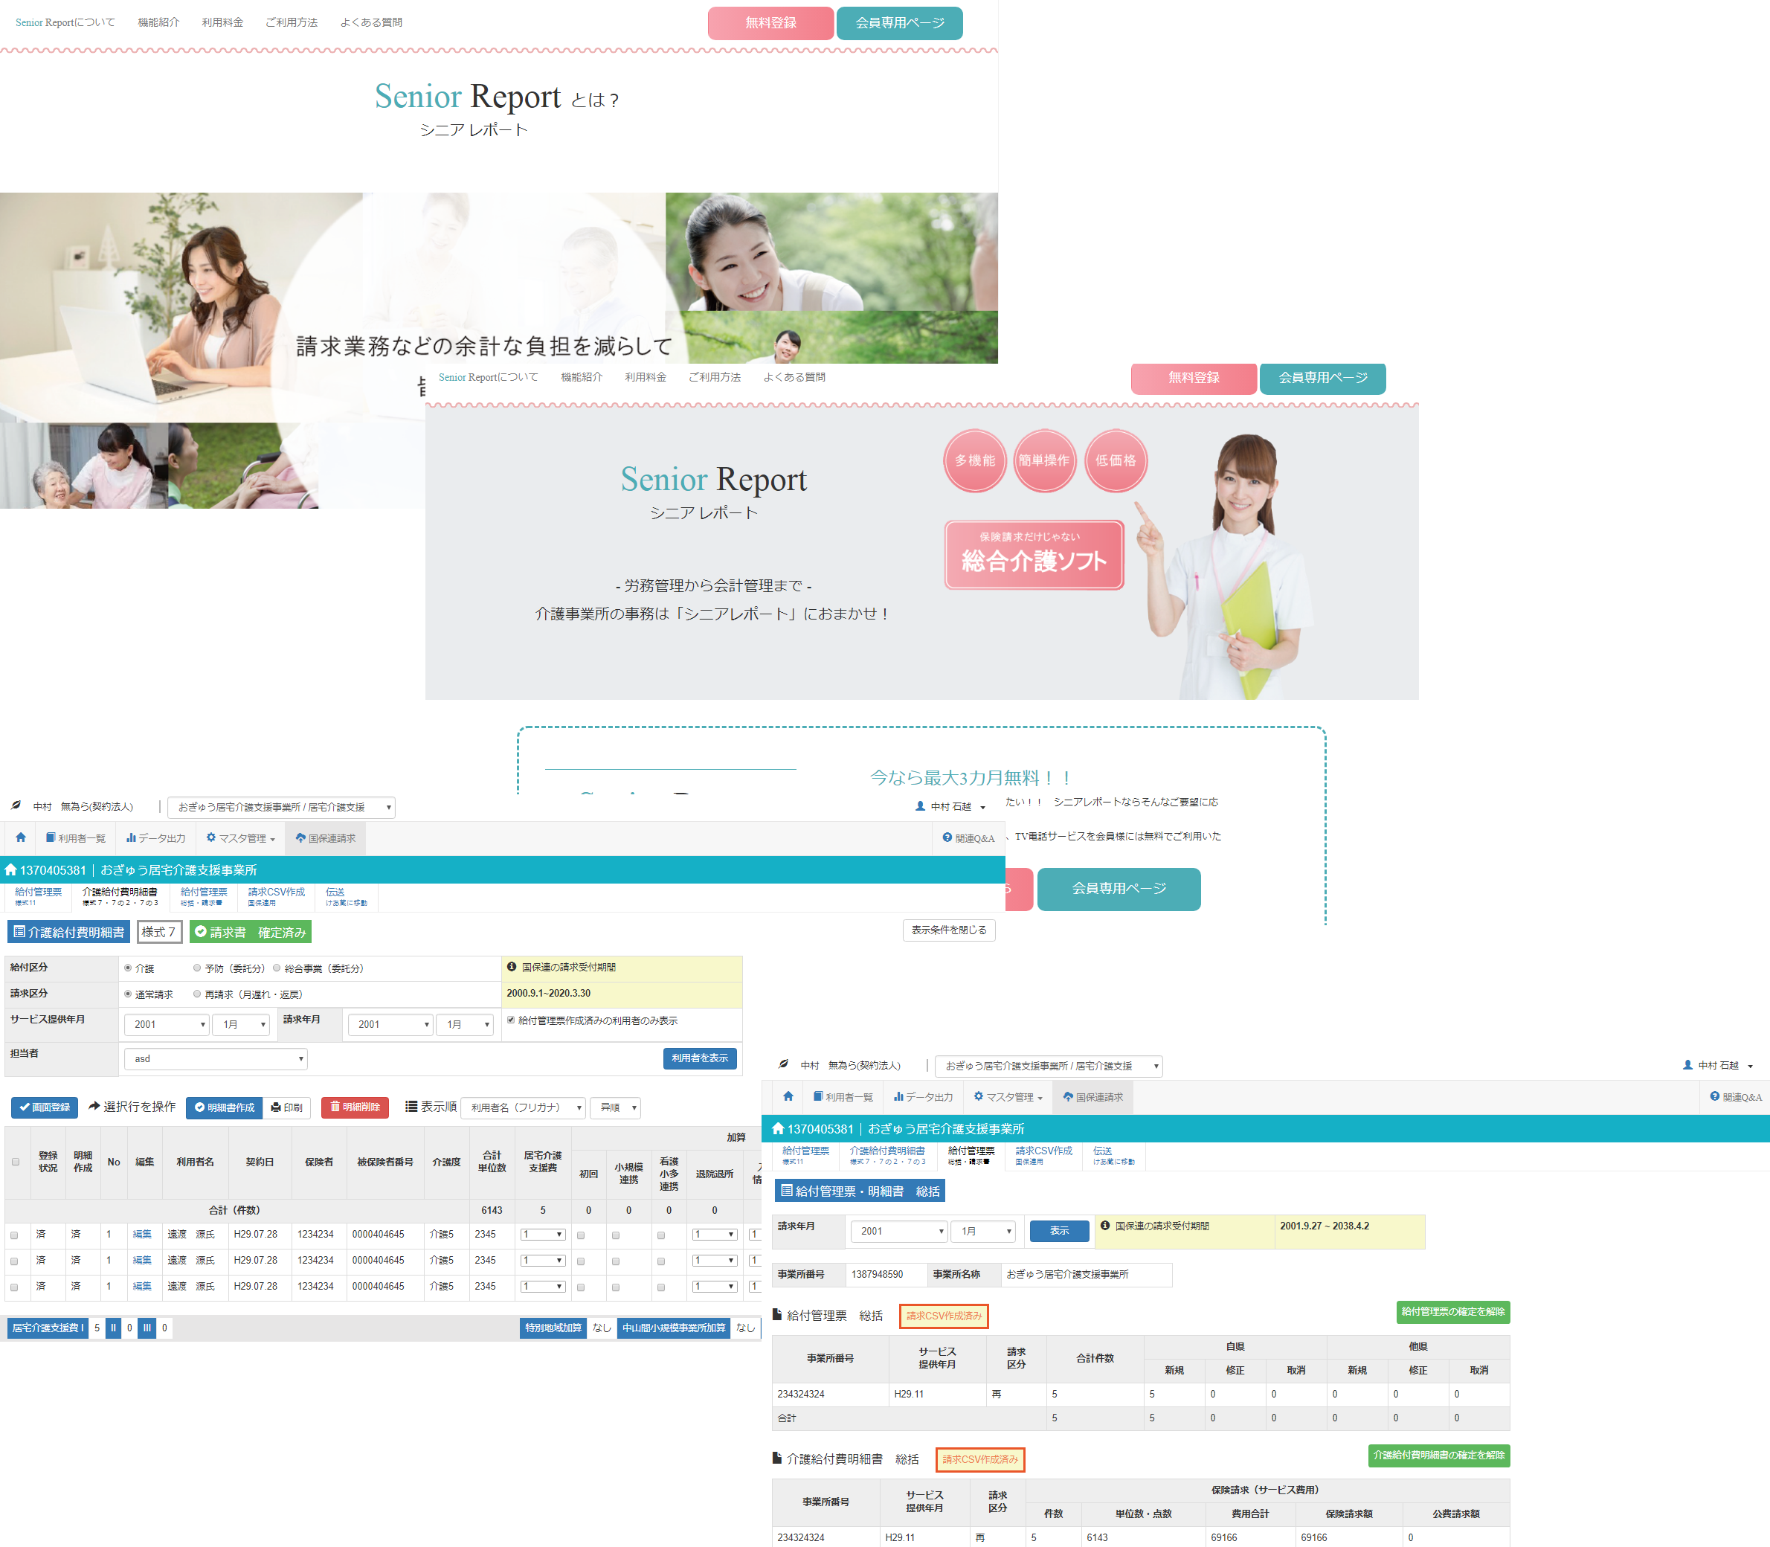

Slide 25

Summary
This project is Report system of institution for the aged.
Every family can be performed several services from Senior Institution within alive connection using this site.

Slide 26
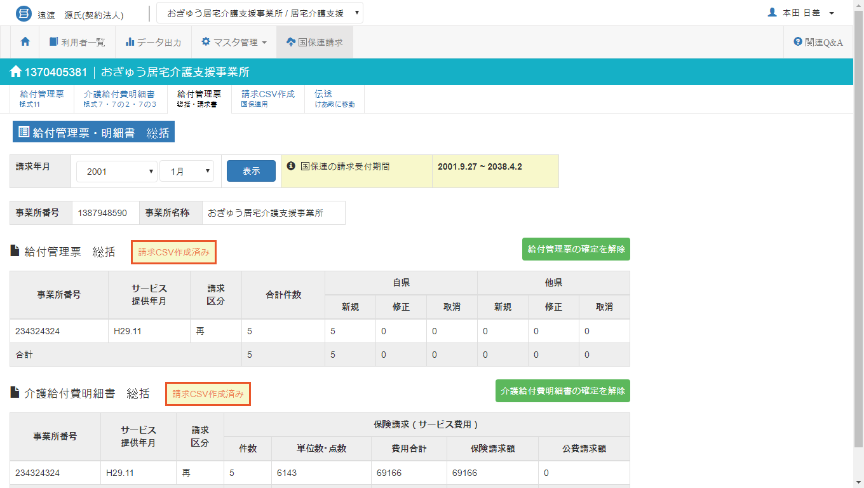
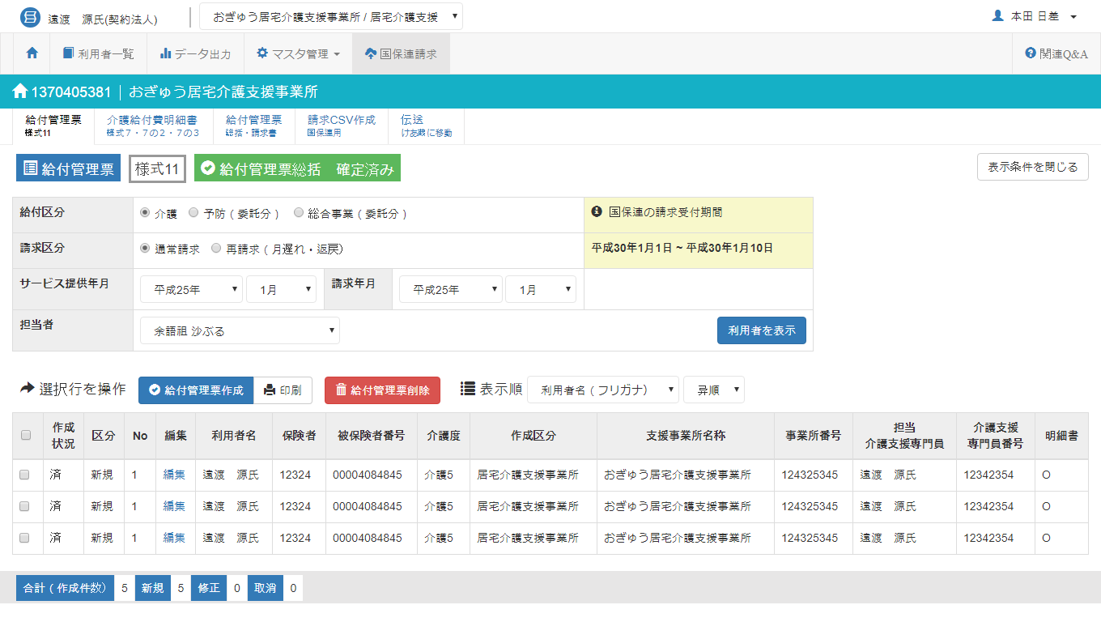
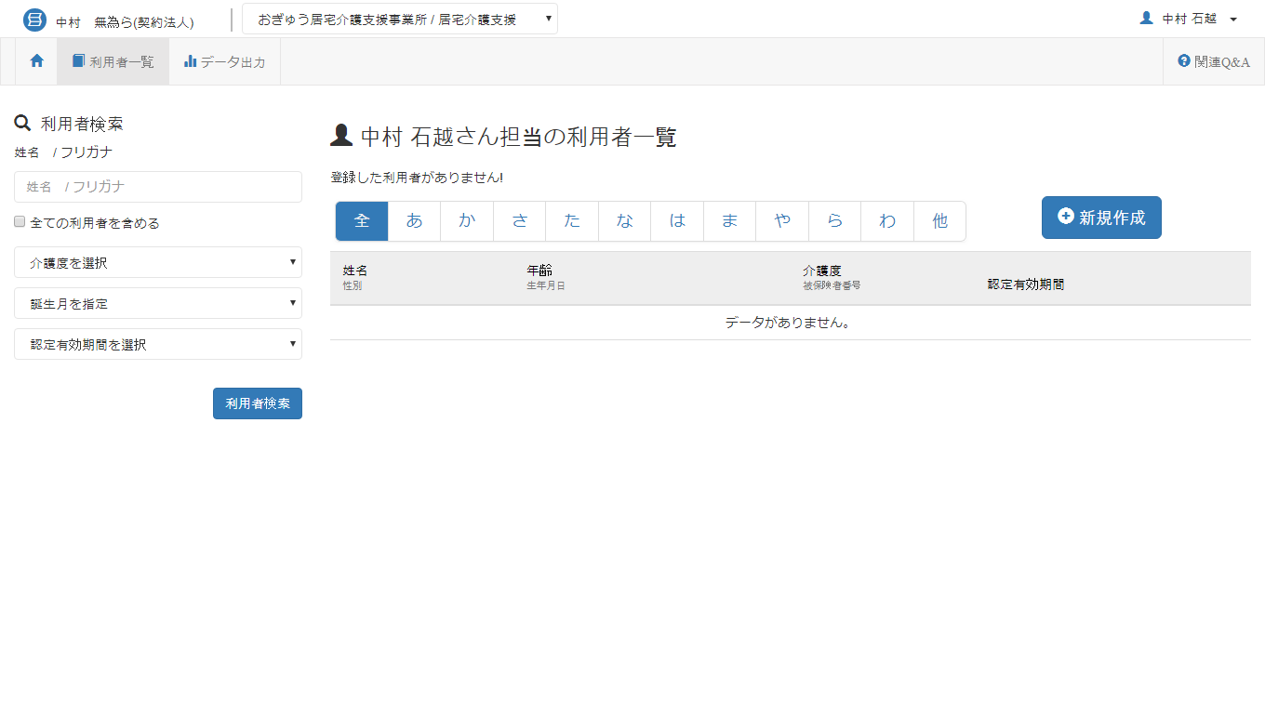
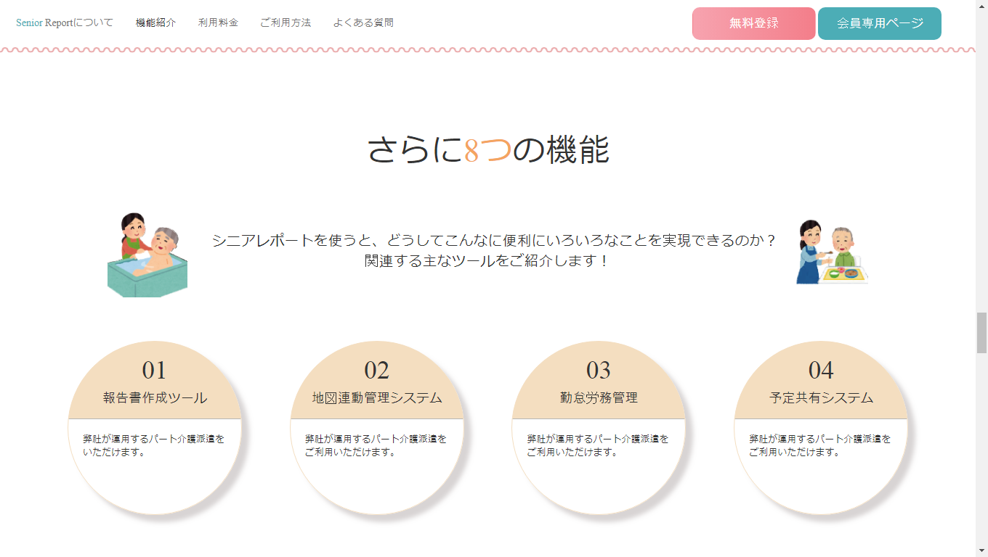

Slide 27
Thanks for your attention.

